Slide 1
Non functional requirements
[N1] MyTaxiService’s system should be available 24/7.
[N2] The waiting time for a taxi to come that is showed to customers should be updated every 30 seconds.
[N3] Every functionality offered by the mobile or web application after the login should be reachable within three clicks.
[N4] Mobile applications’ button available to taxi drivers should be big enough to be easily recognized and pressed while driving.

Slide 2
Non functional requirements
[N5] Code should be well documented in order to facilitate extendibility.
[N6] Email sent to the user in order to confirm registration should arrive in less than 10 minutes.
[N7] Web and mobile applications should have a similar graphics so that the correlation between the two would be immediately identified by customers.

Slide 3
Non functional requirements
[N8] Mobile’s notifications should appear even when the user has not the app opened.
[N9] The description of the mobile application in the phone app store should point out clearly and briefly its functions, allowing a quick comprehension from any type of user.
[N10] MyTaxiService’s applications should always have imperceptible response time during the navigation within its forms.

Slide 4
Scenario with mockups
Let’s see a possible scenario of use of MTS’s application with some explicative mockups.
Suppose that the student Luca Bianchi has to go to Politecnico di Milano to have an exam.
Unfortunately, TRENORD has other plans: in fact, a strike is arranged exactly the day of Luca’s exam.
Knowing that, Luca cautiously decide to reserve himself a taxi using an application his friends have been talking about: MyTaxiService.
He turn on his laptop and after a quick google search he finds MTS’s website.
.

Slide 5
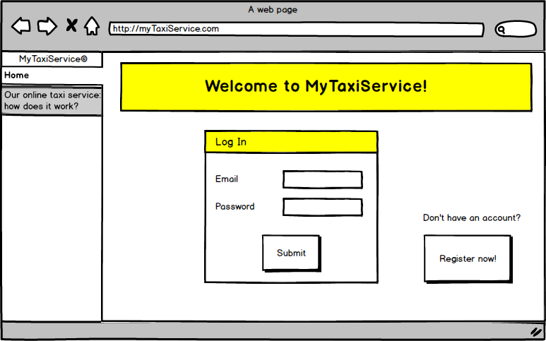
This is how the home of the web application looks like:
Luca has never used MyTaxiService before, so he doesn’t have an account.
Since an account is required to access MTS’s services, he clicks on the “Register now” button.

Slide 6
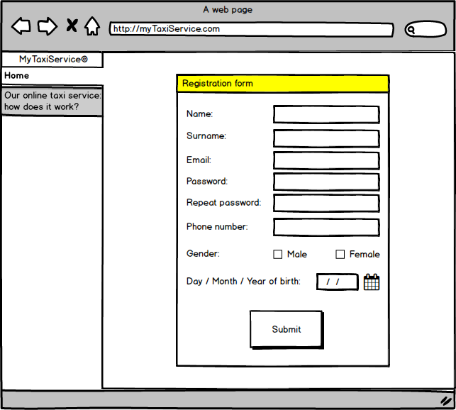
The following registration form appears.
Luca quickly fills in all the fields and clicks “Submit”.

Slide 7
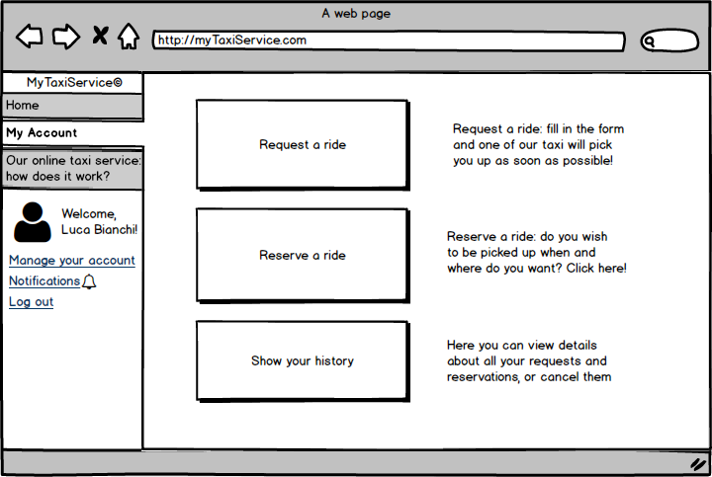
A few minutes later, Luca receives an email that confirms his registration. He goes back to MTS’s home, fills in the email and password fields, and logs in. The following screen appears:
The “Reserve a ride” service seems to be suitable to Luca’s needs, so the student clicks on the correspondent button.

Slide 8
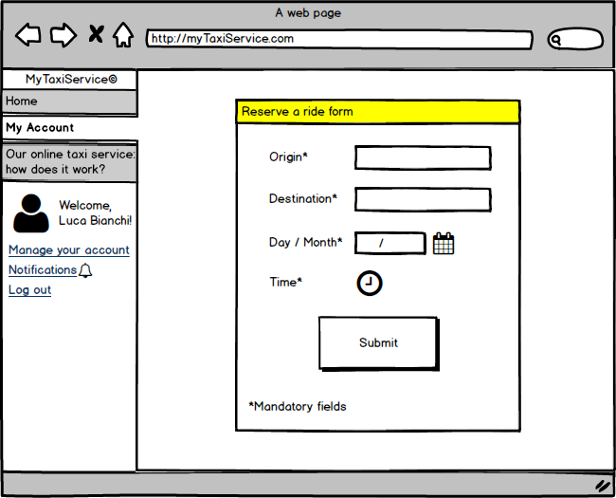
Luca compiles the following form with required information.
He presses the “Submit” button, and shortly after a pop-up confirms that his reservation has been accepted by the system.

Slide 9
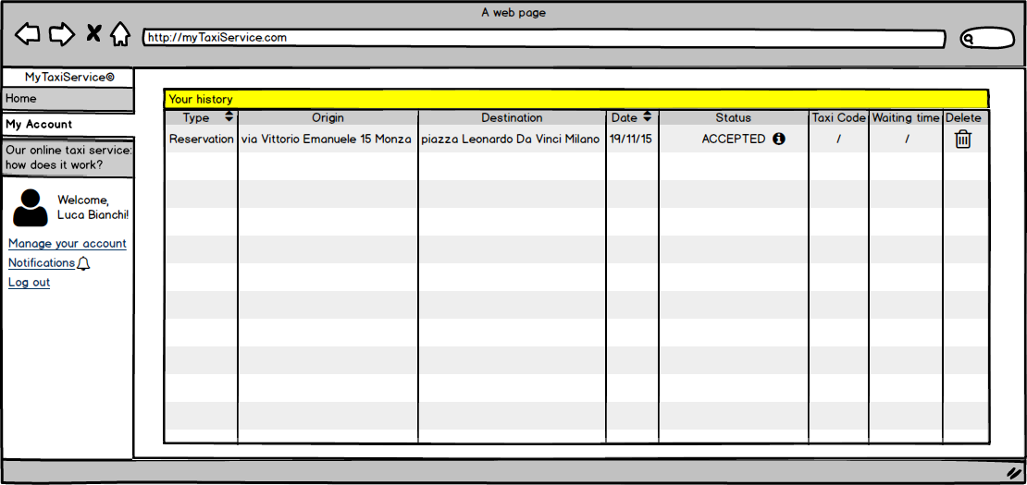
Using the “Show your history” function, Luca has another confirmation that his reservation has been regularly taken care by the system.
He notice also that he has the possibility to delete the reservation.

Slide 10
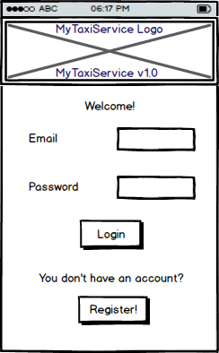
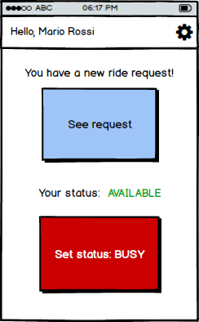
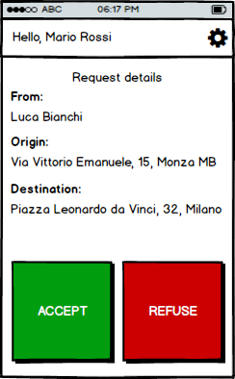
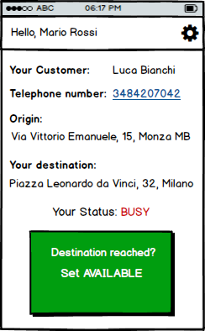
Early in the morning, the day of Luca’s exam, the taxi driver Mario Rossi is starting his workshift. Mario enters his taxi and opens MTS’s app on his mobile phone.
He inserts his driver’s account information in the home and logs in.
Now he is about to turn on the engine when he sees that the system has already a ride request for him.
Mario taps on “See request”, and the details appear on his phone’s screen.
He then decide to accept the request, and he taps on the green button.
The app is now displaying all the required information, and Mario can easily reach Luca’s home.

